Slide 1
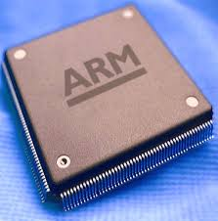
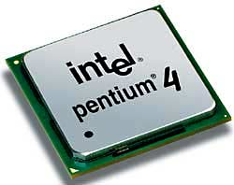
Microprocessor & Computer Architecture
UE18CS253
UNIT-1
Session – 8
Interrupt Instructions
Credits:
MPCA Team
SESSION JAN-MAY 2020
1
Notes:
1

Slide 2
The ARM Instruction Set
Software Interrupts
SESSION JAN-MAY 2020
2

Slide 3



What is Interrupt/Exception?
Main ()
{
:
Doing something
(e.g.
browsing)
:
} ring
Phone rings
Can happen anytime
Depends on types of interrupts
_isr() // Interrupt service routine
{
some tasks (e.g. answer
telephone)
} //when finished,
//goes back to main
Phone
rings
SESSION JAN-MAY 2020
3
Notes:
10-Jan-20
3

Slide 4
Examples
When your computer is running, a key press will trigger an interrupt to input a character to your system.
The dispatcher in the operating system is implemented by timer interrupt.
Timer interrupts the CPU at a rate of 1KHz
At each interrupt the system determines which task to run next.
SESSION JAN-MAY 2020
4

Slide 5
Important Interrupts
SWI
Interrupts
Reset
(or power up)
Software
Interrupt
SWI-XX
Hardware
Interrupt
FIQ,IRQ
Triggered by the software instruction SWI x
Triggered by hardware sources
Triggered by power_up/
reset_key
Timer
ADC
External
Interrupt
EINT
SESSION JAN-MAY 2020
5

Slide 6
Interrupt and Exception
The terms are used differently by various manufacturers
Traditionally exception means
The normal operation of a program is interrupted and the processor will execute another piece of software (exception handling) somewhere.
Interrupt (hardware interrupt) is an exception caused by some hardware condition happening outside the processor (e.g. external hard interrupt, IRQ FIQ).
Software interrupt (SWI) is an exception caused by an assembly software instruction (SWI 0x?? exception call instruction) written in the software code.
Trap is an exception caused by a failure condition of the processor (e.g. abort “pre-fetch , data” , undefined instruction, divided by_zero, or stack overflow etc)
SESSION JAN-MAY 2020
6

Slide 7
Important Interrupts in words
Reset, a special interrupt to start the system– happens at power up , or reset button depressed)
Software interrupt SWI :
Similar to subroutine – happens when “SWI 0x??” is written in the program
Hardware interrupt
FIQ (fast interrupt) or IRQ (external interrupt), when
the external interrupt request pin is pulled low, or
an analogue to digital conversion is completed, or
A timer/counter has made a regular request
SESSION JAN-MAY 2020
7

Slide 8
Compare hardware and software interrupt
Hardware interrupt, e.g.
Software interrupt
A falling edge at EINT3 will trigger the
execution of the interrupt service routine
__irq IRQ_Eint1()
IRQ_Eint1()
{
::
}
Computer
EINT3
Computer
Main{
:
SWI N
:
}
An instruction “SWI N” in
the program will trigger the
execution of
the N-th-sys-routine
(system routine)
N-th-sys-routine()
{
::
}
SESSION JAN-MAY 2020
8

Slide 9
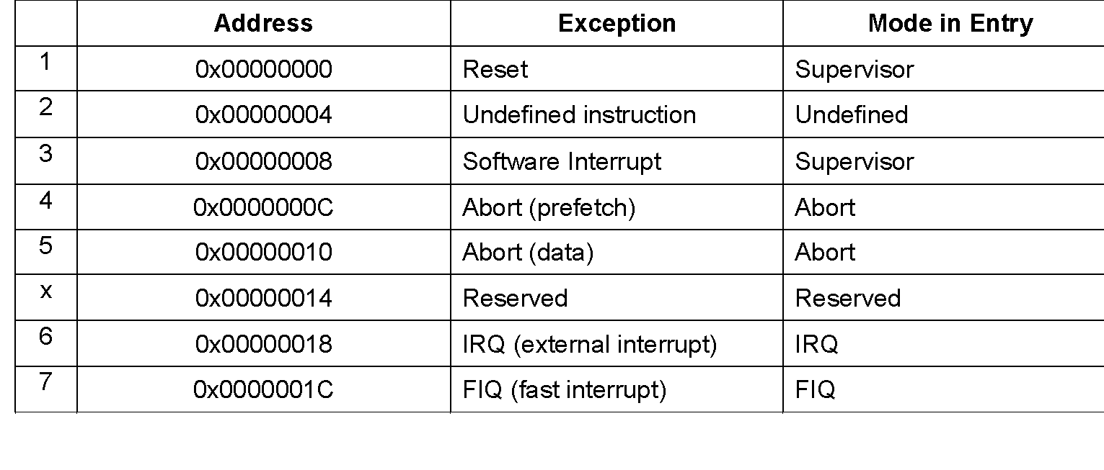
Exception (interrupt) Modes
ARM supports 7 types of exceptions and has a privileged processor mode for each type of exception.
ARM Exception (interrupt) vectors
SWI
SESSION JAN-MAY 2020
9

Slide 10
SWI Interrupt Procedures
(enter the supervisor mode)
SWI (software interrupt )
Caused by “SWI 0x??” in your program
Arm completes the current instruction.
Goto SWI exception address 0x08 (short form for 0x 0000 0008)
{Change to supervisor op. mode :CPSR (bit0-4)
:
:
Return from interrupt
MOVS pc, lr
return to main}
SESSION JAN-MAY 2020
10

Slide 11
Software Interrupts: 'Supervisor Call’
Whenever a program requires input or output, for instance to send some text to the display, it is normal to call a supervisor routine.
To read data from the keyboard or to display the contents on the console
The supervisor is a program which operates at a privileged level, which means that it can do things that a user-level program cannot do directly.
The limitations on the capabilities of a user-level program vary from system to system, but in many systems the user cannot access hardware facilities directly.
The supervisor provides trusted ways to access system resources which appear to the user-level program rather like special subroutine accesses.
SESSION JAN-MAY 2020
11

Slide 12
The instruction set includes a special instruction, SWI, to call these functions, (SWI stands for 'Software Interrupt', but is usually pronounced 'Supervisor Call').
Note: In privileged modes there is another register for each mode called Saved Processor Status Register (SPSR).
The SPSR is used to save the current CPSR before changing modes.
SWI interrupt occurs when the SWI instruction has been fetched and decoded successfully, and none of the other higher priority exceptions/interrupts have been flagged.
Upon entry to the handler the CPSR will be set to SVC mode.
Note: If a SWI calls another SWI (which is a common occurrence), then to avoid corruption, the link register (LR & SPSR) must be stacked away before branching to the nested SWI.
SESSION JAN-MAY 2020
12

Slide 13
Example 1 :
A procedure to compute the statement in high level language using ARM ALP.
if (R0==R1) R2++;
MOV R0, #10
MOV R1, #10
BL GREAT
SWI 0x11; terminate the program / logical end.
GREAT: CMP R0, R1
ADDEQ R2, R2, #1
MOV PC, LR
SESSION JAN-MAY 2020
13

Slide 14
Example 2 :
A program to display a string on the screen using ARM ALP.
System.out.print (“ Hello World”);
LDR R1, =A
LOOP: LDRB R0, [R1], #1
CMP R0, #0
SWINE 0x00 ; display a character on the screen.
BNE LOOP
SWI 0x11 ; terminate the program.
.DATA
SESSION JAN-MAY 2020
14

Slide 15
Example 3 : What does the code do?
A procedure to display a string on the screen using ARM ALP.
// System.out.print (“ Hello World”);
LDR R1, =A
BL strprint ; call display routine
SWI 0x11 ; terminate the program.
strprint: LDRB R0, [R1], #1
CMP R0, #0
SWINE 0x00 ; display a character on the screen.
BNE strprint
MOV PC, LR
LDR R0, =A
SWI 0x02 ; display a string on the screen
SWI 0x11
.DATA
A: .ASCIZ “HELLO WORLD”
SESSION JAN-MAY 2020
15
Notes:
15

Slide 16
Q & A on Software Interrupts
SESSION JAN-MAY 2020
16
Notes:
16

